Slide 1



Garbage collection System
Team-A7
Presented by
Ahmed Nur Ratul
Md Rakibul Islam
Editted By Nur Ratul
Date
Website
E-mail
03 August 2026
https://github.com/nurRatul/Project-A7
ratulnur9435@gmail.com

Slide 2

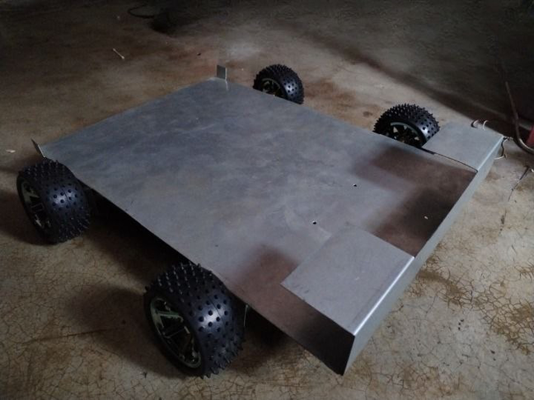

Slide 3
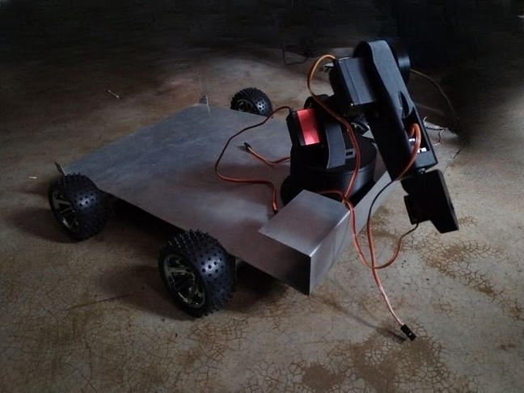

Slide 4


THANK
YOU

